Slide 1

IoC and DI with Ninject
5 – Using Ninject

Slide 2
Overview
What is an IoC container?
Manual constructor injection

Slide 3
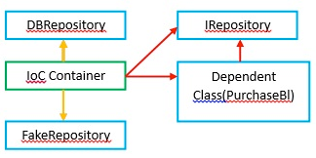
What is a container?
Manages the rules of dependency
Creates objects
Injects dependencies
Manages object lifetime

Slide 4
Summary
Ninject is a great IoC container
Very flexible in options for creating objects
Interception framework is great for AoP

